Slide 1
송신단
Constellation
설계
입력 비트열
비트-컬러
인코딩
심볼 패킷화
디스플레이 출력
송신
수신단
YOLO & 차 영상
컬러 바코드 추출
광학카메라 촬영
수신
출력 비트열
수신 신호 디코딩
채널 추정
동기화

Slide 2
N^{th} Packet
(N+1)^{th} Packet
…
Pilot
Data
Pilot
Data
…
RR`GG`BB`
CC Pairs
RR`GG`BB`
CC Pairs

Slide 3
R
R`

Slide 4
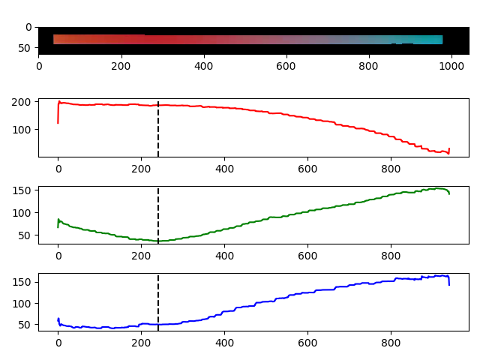

Slide 5
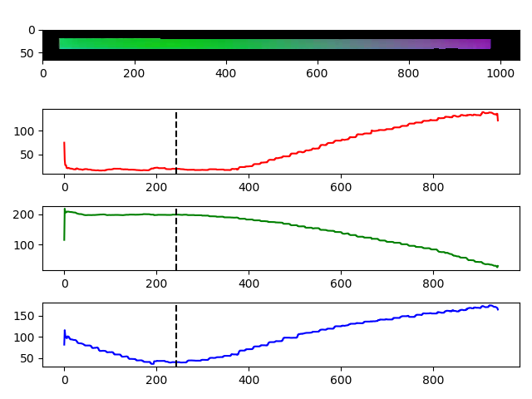

Slide 6
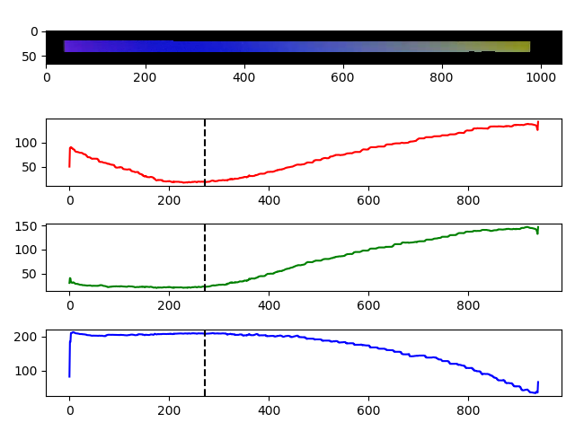

Slide 7
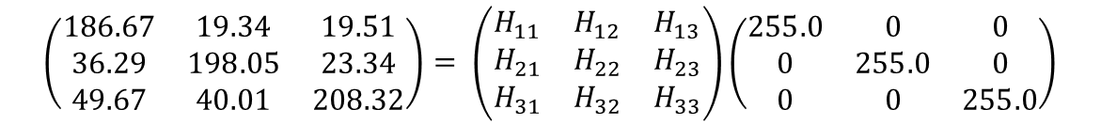
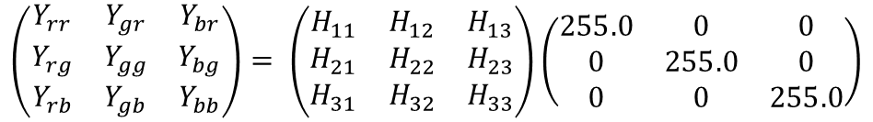
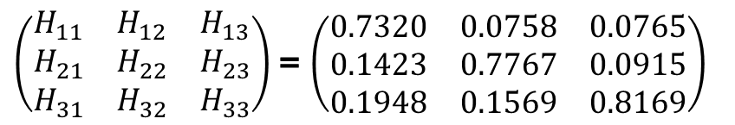
$$\left(\begin{matrix}Y_{rr} & Y_{gr} & Y_{br} \\ Y_{rg} & Y_{gg} & Y_{bg} \\ Y_{rb} & Y_{gb} & Y_{bb}\end{matrix}\right)= \left(\begin{matrix}H_{11} & H_{12} & H_{13} \\ H_{21} & H_{22} & H_{23} \\ H_{31} & H_{32} & H_{33}\end{matrix}\right)\left(\begin{matrix}255.0 & 0 & 0 \\ 0 & 255.0 & 0 \\ 0 & 0 & 255.0\end{matrix}\right)$$
$$\left(\begin{matrix}186.67 & 19.34 & 19.51 \\ 36.29 & 198.05 & 23.34 \\ 49.67 & 40.01 & 208.32\end{matrix}\right)= \left(\begin{matrix}H_{11} & H_{12} & H_{13} \\ H_{21} & H_{22} & H_{23} \\ H_{31} & H_{32} & H_{33}\end{matrix}\right)\left(\begin{matrix}255.0 & 0 & 0 \\ 0 & 255.0 & 0 \\ 0 & 0 & 255.0\end{matrix}\right)$$
$\left(\begin{matrix}H_{11} & H_{12} & H_{13} \\ H_{21} & H_{22} & H_{23} \\ H_{31} & H_{32} & H_{33}\end{matrix}\right)$ = $\left(\begin{matrix}0.7320 & 0.0758 & 0.0765 \\ 0.1423 & 0.7767 & 0.0915 \\ 0.1948 & 0.1569 & 0.8169\end{matrix}\right)$

Slide 8
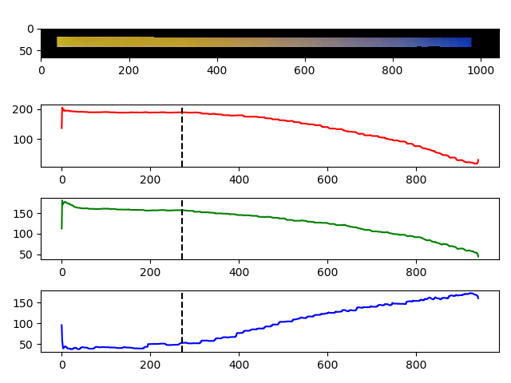
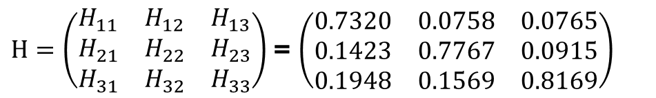
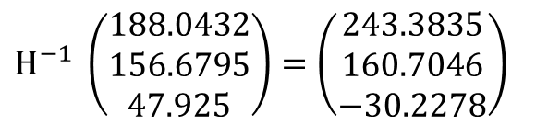
$H=\left(\begin{matrix}H_{11} & H_{12} & H_{13} \\ H_{21} & H_{22} & H_{23} \\ H_{31} & H_{32} & H_{33}\end{matrix}\right)$ = $\left(\begin{matrix}0.7320 & 0.0758 & 0.0765 \\ 0.1423 & 0.7767 & 0.0915 \\ 0.1948 & 0.1569 & 0.8169\end{matrix}\right)$
$H^{−1} \left(\begin{aligned}188.0432 \\ 156.6795 \\ 47.925\end{aligned}\right)=\left(\begin{aligned}243.3835 \\ 160.7046 \\ −30.2278\end{aligned}\right)$

